Slide 1

The Decisional Project
Data Warehousing System for Music Analysis
Students:
Akaichi Ines
Cissé Ismaila
de Saint Ceran Louis
Nascimento Filho Jessé F.
Tutors:
Veronika Peralta
Christine Farmer
Marcel Patrick
Master of Big Data Management and Analytics
Notes:
Good morning everyone . Thank you for coming to our presentation. My name is Ines Akaichi and these are my fellow presenters : Jesse ,Louis and Ismaila.
The topic of our presentation today is implementing a data warehousing system for music analysis and this is part of our 1st year master degree program of Big data management and analytics.

Slide 2
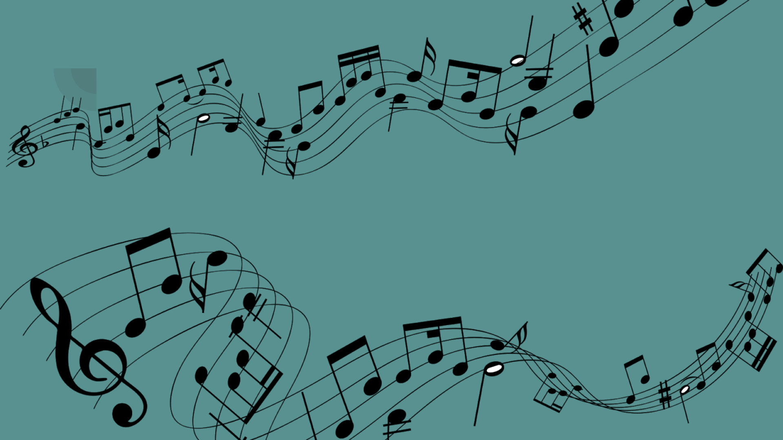
Motivation
Goals
Motivation
Goals
WTF
Notes:
Motivation : How would you go about describing your favorite new song? What makes it catchy to you? According to the people at Spotify, characteristics like energy or mood of a song can actually be quantified, and have many algorithms to describe music in an amazing amount of ways.
Goals: designing and implementing a datawarehousing sytem that aims to analyse artist and song based on song features and popularity.
other workloads will be specified later in the presentation.

Slide 3
Data warehouse design
ETL process
Analysis
Plan
Notes:
Three main sections will be discussed today : DW design , ETL process and the performed analysis on our designed datamarts.

Slide 4
Data warehouse design
Notes:
Three main sections will be discussed today : DW design , ETL process and the performed analysis on our designed datamarts.

Slide 5





Data warehouse design
Data sources
Data marts
Preliminary workload
Spotify API
Music Brainz
Web scrolling
Notes:
This phase consisted in in specifying conceptual schemas based on a preliminary workload that were identified and than mapped to our chosen data sources.
This approach called design based requirements.
Two main datasources were used : music brainz database and the spotify web api .
Besides , we used web scrolling to reurtn the covers for our extracted artists.

Slide 6
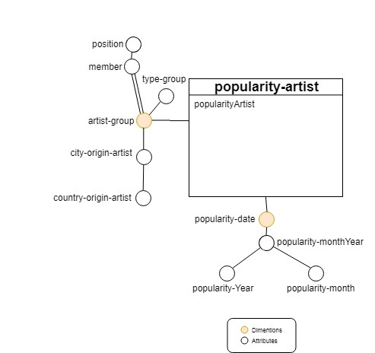
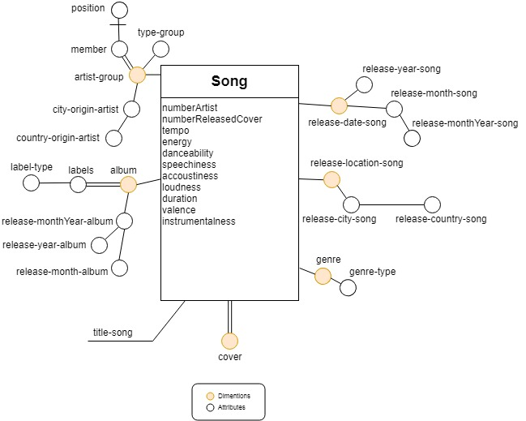
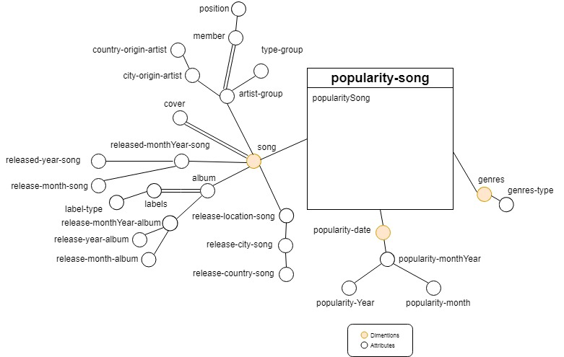
Data warehouse design
Notes:
Our first datamart is Song.it is designed to be populated by released song with their first released date.Each row is a song .
Our second datamart is popularity-artist. It is designed to track popularity of artists every month.
Finally , the popularity-song datamart . In This datamart we track the popularity of songs every month.
Popularity-song and popularity-artist would be updated every month , artist and song ‘s popularities changes every month by spotify, Whereas the datamart song will be only updated when inserting new rows.

Slide 7
ETL process
Notes:
Three main sections will be discussed today : DW design , ETL process and the performed analysis on our designed datamarts.

Slide 8





ETL Process
EXTRACTION
SQL Connection
Too slow, too heavy

Slide 9
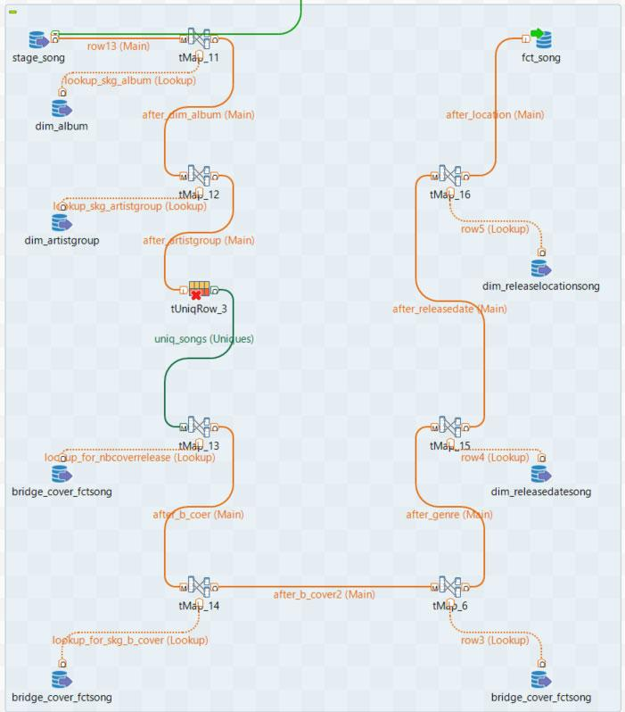
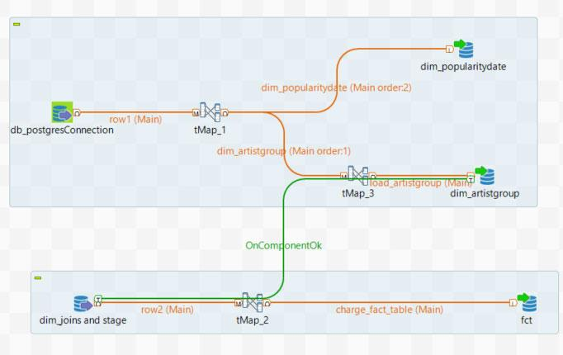





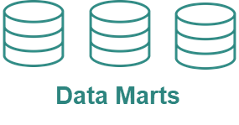




ETL Process
EXTRACTION
TRANSFORMATION
LOAD
Docker
Music Brainz
Data Staging Area
Python
Spotify

Slide 10

ETL Process
Search (q)
Data inconsistency
Spotify API
Artist (id spotify)
Correction of data inconsistency
Music Brainz
Kaggle
Notes:
Problemes when extracting :
We had two sources of data. Music brainz database and spotify. At first we looked for music brainz artists with their home countries and we mapped them with spotify artists using endpoint search.
This endpoint takes an artist name as a parameter and returns its spotify id which will be used later to return the spotify songs and albums using other spotify enpoints.
This approach left us with data inconsistency.For exemple we found in our staging table the artist JenniferLopez with frensh origin.
In fact when searching for another artist that ‘s name is Jennifer , spotify returned the first artist Jennifer Lopez .
Not knowing that this would happen , we inserted in our stage the returned spotify name Jennifer lopez with the origin artist of the other artist.
We could tell that Spotify ‘s search endpoint is not one of their strongest point.
Remedies :
we found on Kaggle spotify artists with their ids.
(Kaggle is an online community of data scientists and machine learners that allows users to find and publish data sets, )
we used then the artist enpoint who takes an id-artist as parameter and returns the object artist. These artists r then was mapped with music btrainz artists .

Slide 11
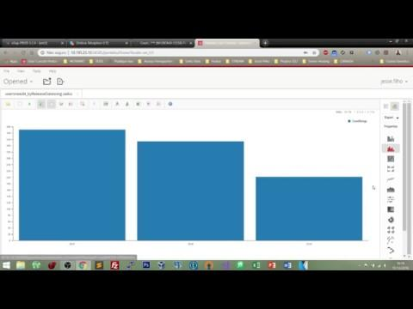
Demo

Slide 12
Analysis
Notes:
Three main sections will be discussed today : DW design , ETL process and the performed analysis on our designed datamarts.

Slide 13
Workload
geographical and time
distribution of artists
and songs.
cover songs and most covered artist.
artist performance and song analysis.
Workload

Slide 14
Profile of a trendy song
Analysis
7 measures :
danceability
intrumentalness
valence
speechiness
tempo
duration
energy
How can we define a popular song
using these measures ?

Slide 15
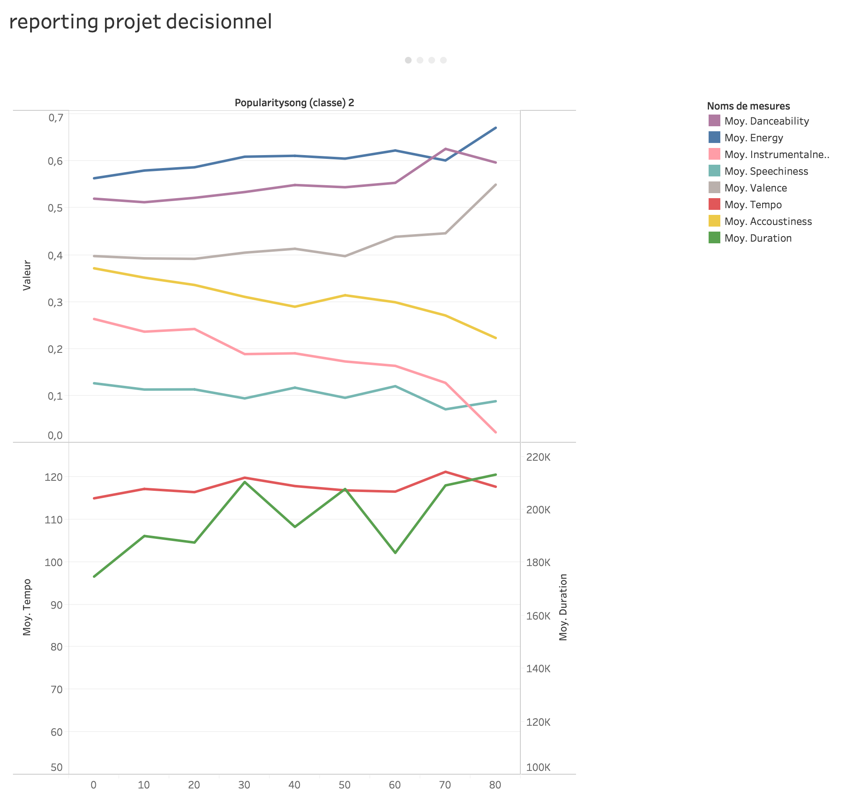
Analysis
measures function of popularity :
danceability, energy and valence go up with popularity.
the contrary for accoustiness speechiness and instrumentalness
best tempo is around 120 bpm
best duration is around 3min30

Slide 16
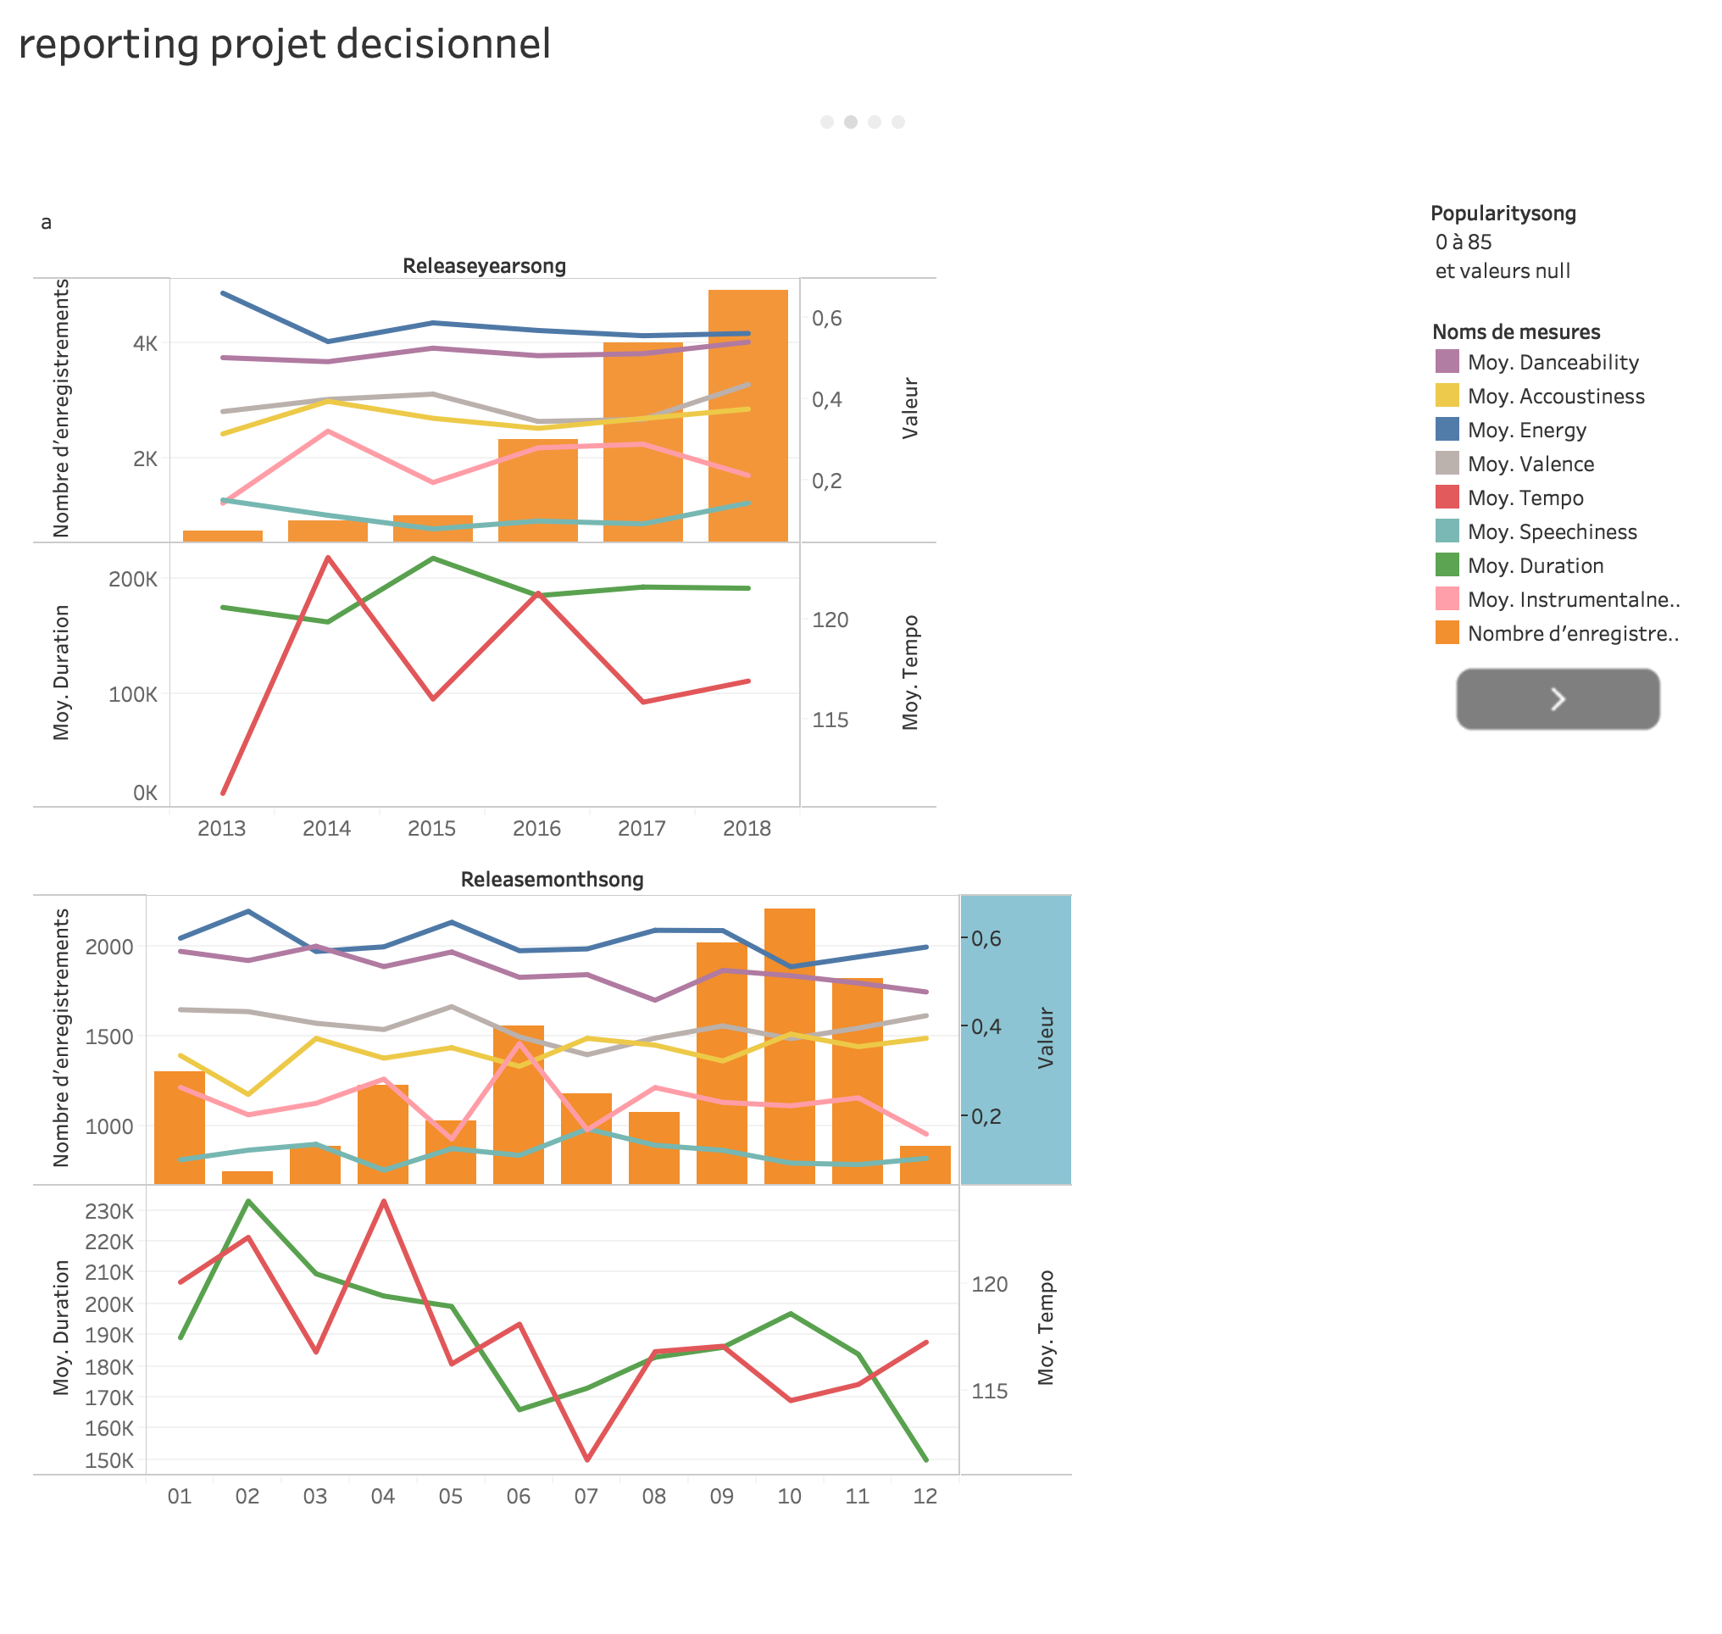
Analysis
measures function by months and years :
most of the measures ‘s variation is steady along years and months.
more and more songs released each year.
most prolific seasons are spring and autumn.
duration and tempo drop during the year.
Notes:
pLus de chansons sont publies /plus simple de publier une chanson
La rentree et le printemps les mois ou il y a un grand nombre de release

Slide 17
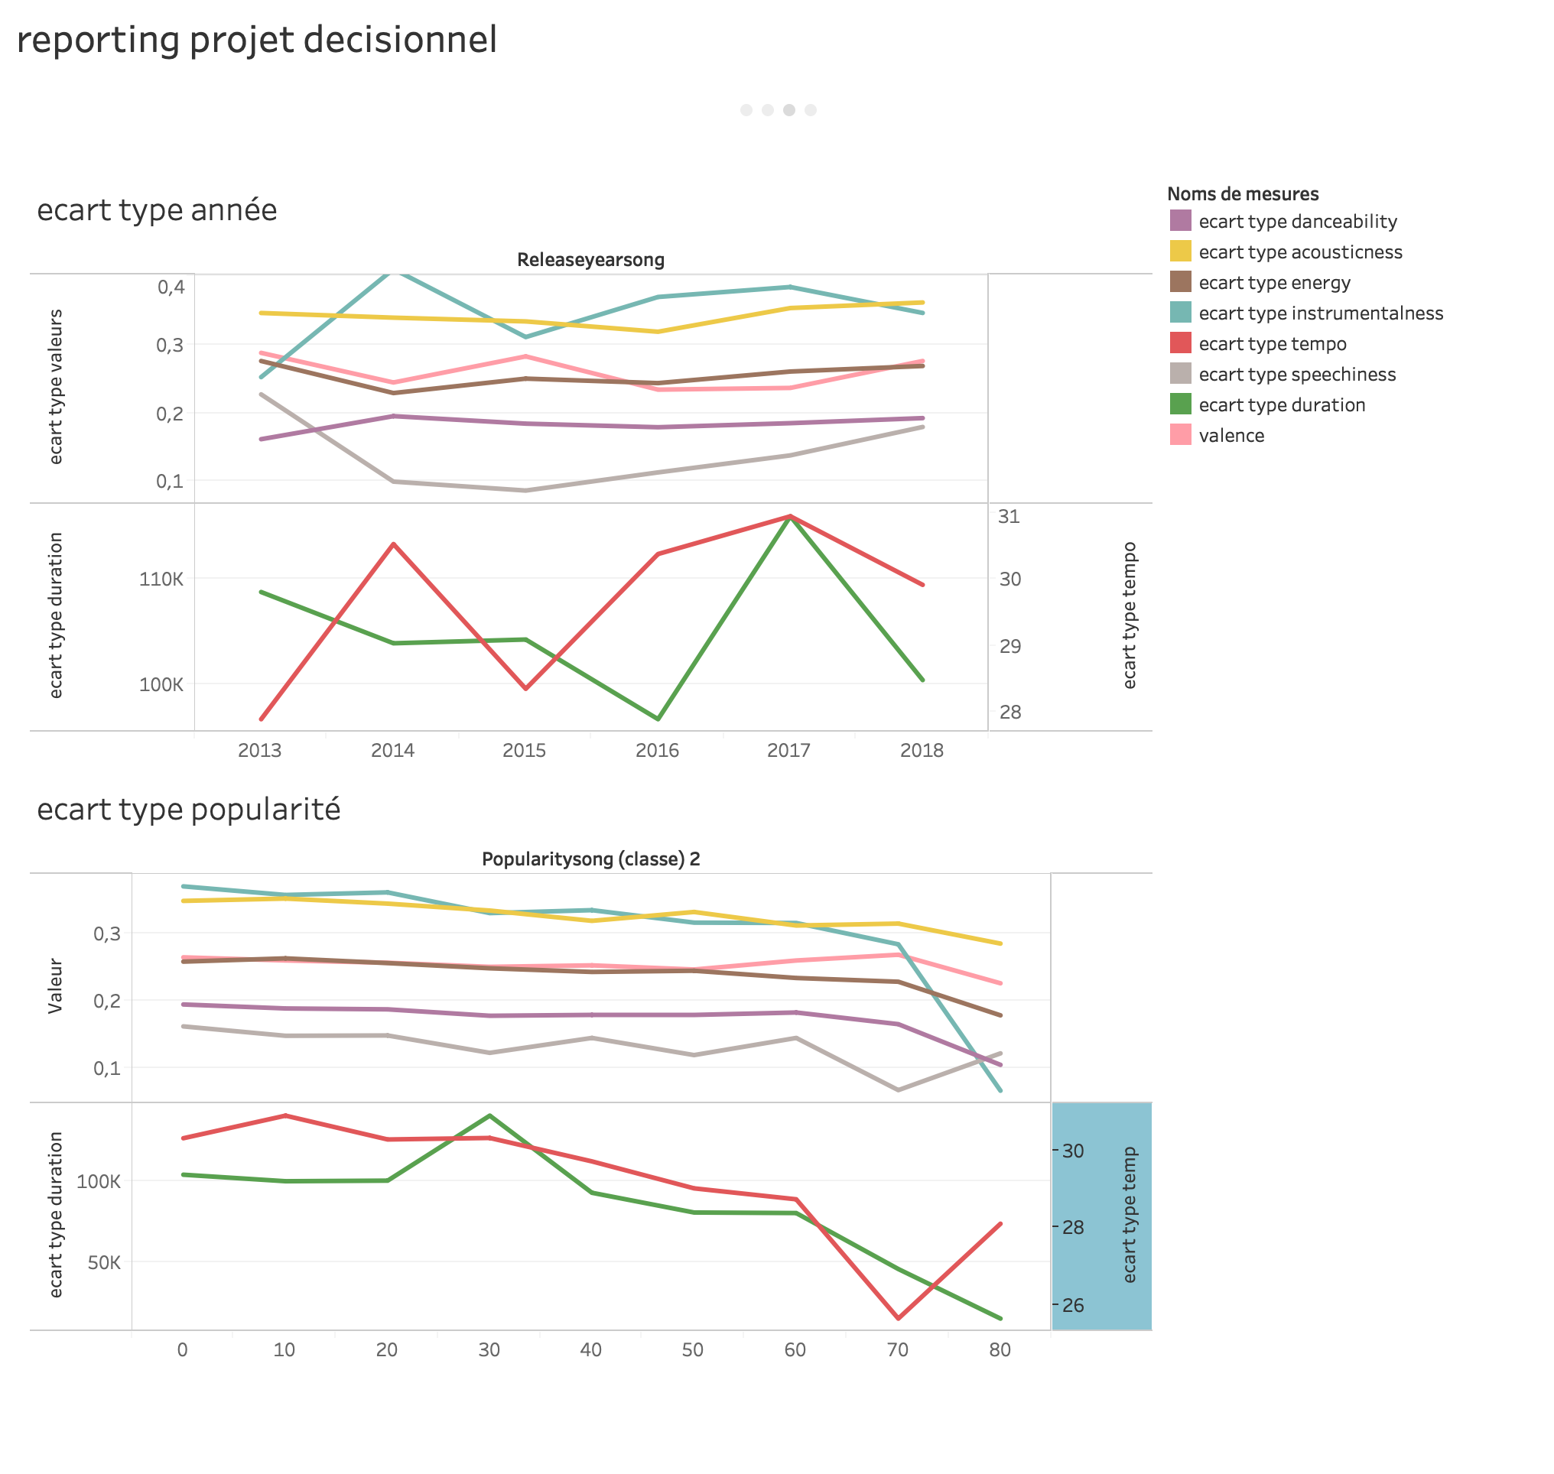
Analysis
Standard deviation function of popularity by years :
no smoothing along the years.
smoothing with the increasing popularity.

Slide 18
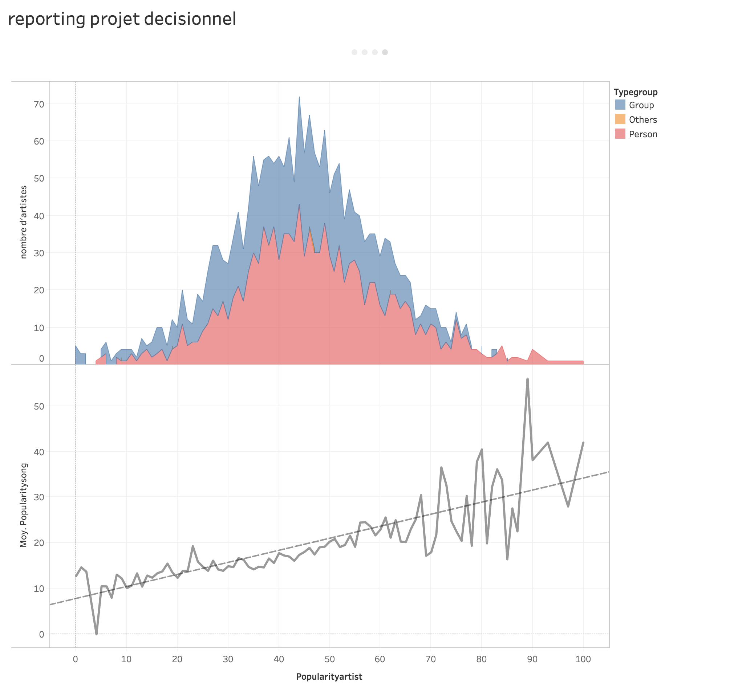
Analysis
how spotify rate artists :
gaussian repartition
popularity artist =
3.8 * popularity songs - 29.46

Slide 19
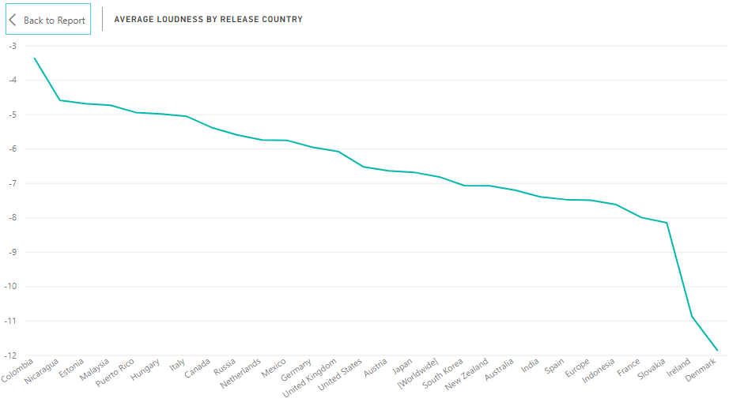
Analysis
Average loudness by country
Guess The loudest Country ?

Slide 20
Future Works
Continue this analysis of popularity metrics with clustering/regression analysis at a further date.
Develop a predictive model and feed information into it via spotify to determine up-and-coming popular artists.

Slide 21
Thank you

